Slide 1
NETWORK STORAGE & DATA LIFECYCLE
ALL ABOUT NETWORK STORAGE & DATA LIFECYCLE

Slide 2
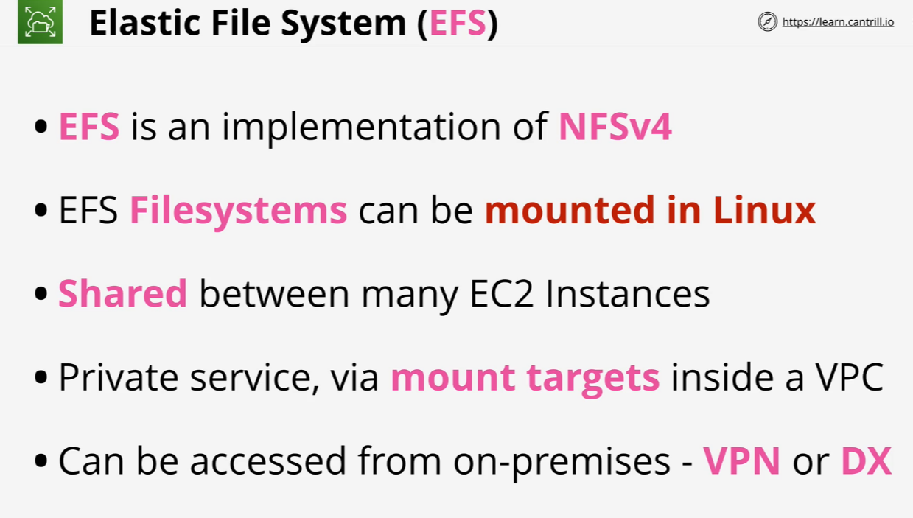
EFS Architecture

Slide 3
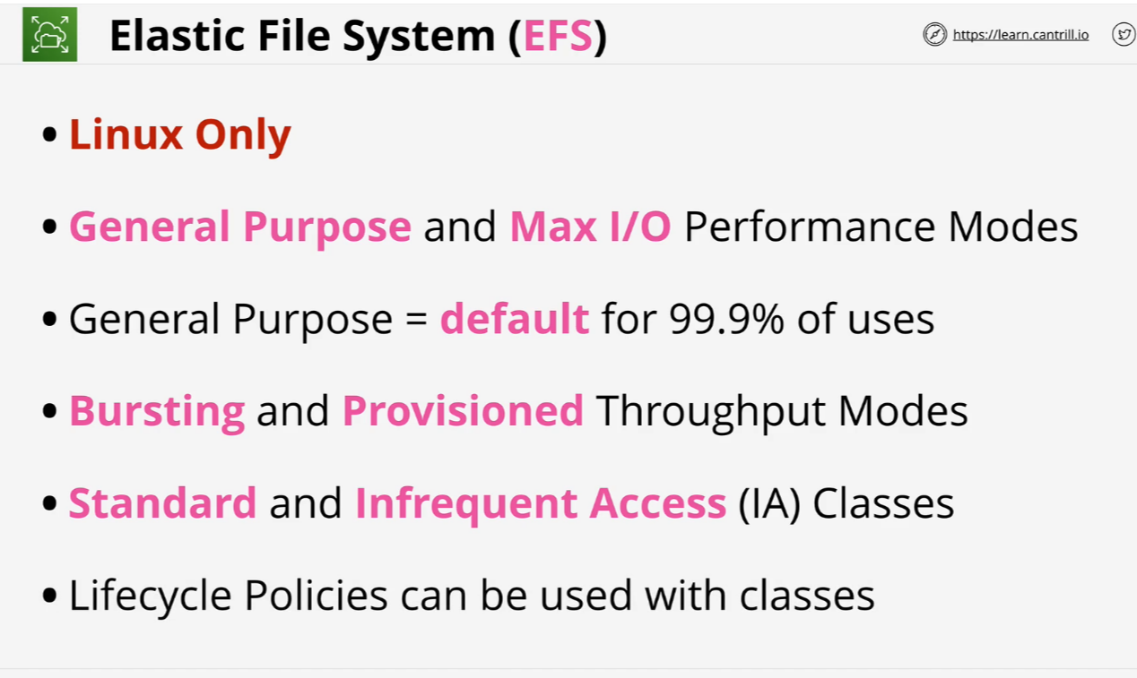
EFS Architecture

Slide 4
[DEMO] Implementing EFS
https://us-east-1.console.aws.amazon.com/cloudformation/home?region=us-east-1#/stacks/quickcreate?templateURL=https://learn-cantrill-labs.s3.amazonaws.com/awscoursedemos/0019-aws-associate-storage-implementing-efs/A4L_TWO_EFS_EC2_AL2023.yaml&stackName=IMPLEMENTINGEFS
After this we go to EFS and create file system there.
After that use these cmds on A and B instances created while CloudFormation Stack.
https://learn-cantrill-labs.s3.amazonaws.com/awscoursedemos/0019-aws-associate-storage-implementing-efs/lesson_commands_AL2023.txt

Slide 5
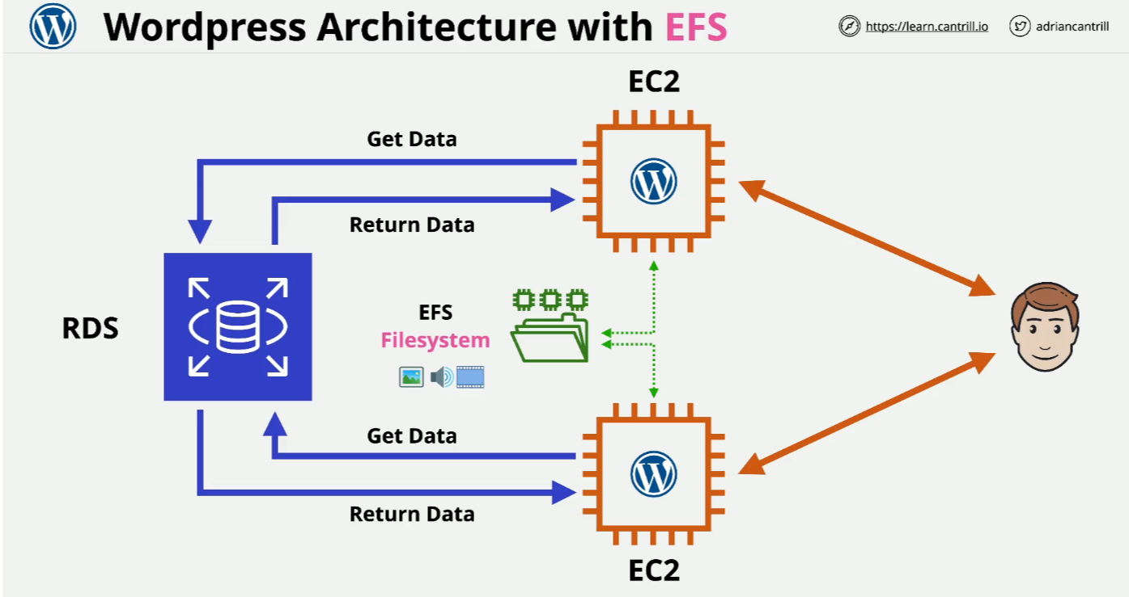
Using EFS with Wordpress

Slide 6
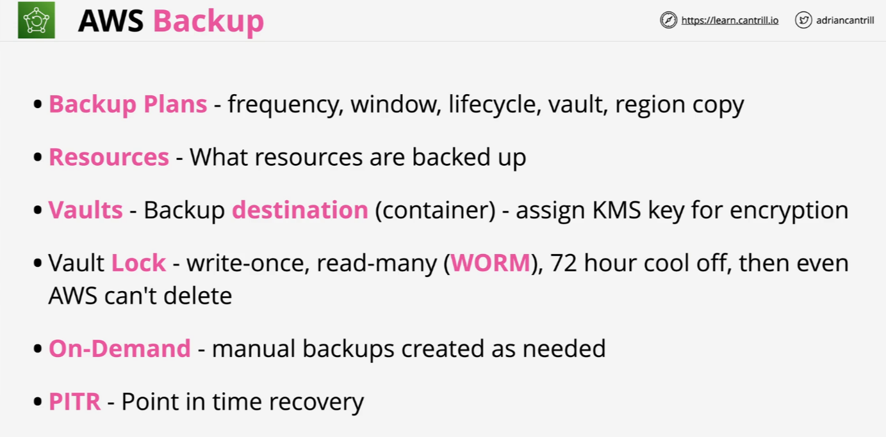
AWS Backup

